Slide 1
Arkansas Medical Society
October 2020
Karen Young
Training and Program Developer, MMIS, AFMC

Slide 2
Agenda
Introduction –AFMC MMIS Outreach Team
Healthcare Portal
Immunizations and Other Vaccines
Training
Who’s Who at Medicaid
Questions
Notes:
Go over the agenda items

Slide 3
Organizational Chart
Notes:
Explain each The Arkansas Department of Human Services is a large organization, within that organization is the Devision of Medical Services(establishes policy, reimbursement rates for all the Medicaid programs)
DXC is the Fiscal Agent for the Medicaid program, which Enrolls provider into the Medicaid program, process claims, issue Ras, houses all of the provider, beneficiary, claim and payment information)
AFMC is a subcontractor for DXC….that is the team that I am on.
Go to next slide to explain what AFMC does.

Slide 4
AFMC
AFMC is a nonprofit organization engaged with beneficiaries and health care providers in all settings to improve overall health and consumers’ experience of care, while reducing health care costs. We accomplish this through education, outreach, data analysis, information technology, medical case review and marketing/communications services.
Webpage: www.afmc.org
Notes:
AFMC does a lot of different things and sometimes people get confused on what our team does.
See next slide to explain the MMIS Outreach team

Slide 5
AFMC | MMIS Outreach Specialist
AFMC’s MMIS Outreach Specialists are available to help Arkansas providers with questions about:
Program policies and procedures
Claim submissions
Provider portal training
Understanding remittance advice
Virtual and on-site training
You can find your provider outreach specialist at www.afmc.org/mmis or on the Arkansas Medicaid Website under
What do you need?
Provider information
Support
AFMC outreach specialists
Choose the option for Medicaid Management Information System (MMIS) outreach specialists
You may contact your outreach specialist by calling 501-906-7566 and choosing the region where your organization resides.
Note: If you would like a one-on-one meeting to answer specific questions after this training, please contact your outreach specialist.
Notes:
Explain how the outreach team uses the policy to assist will the billing. We should always refer you to the policy
Let them know that the Provider Relations team deals with policy issues

Slide 6
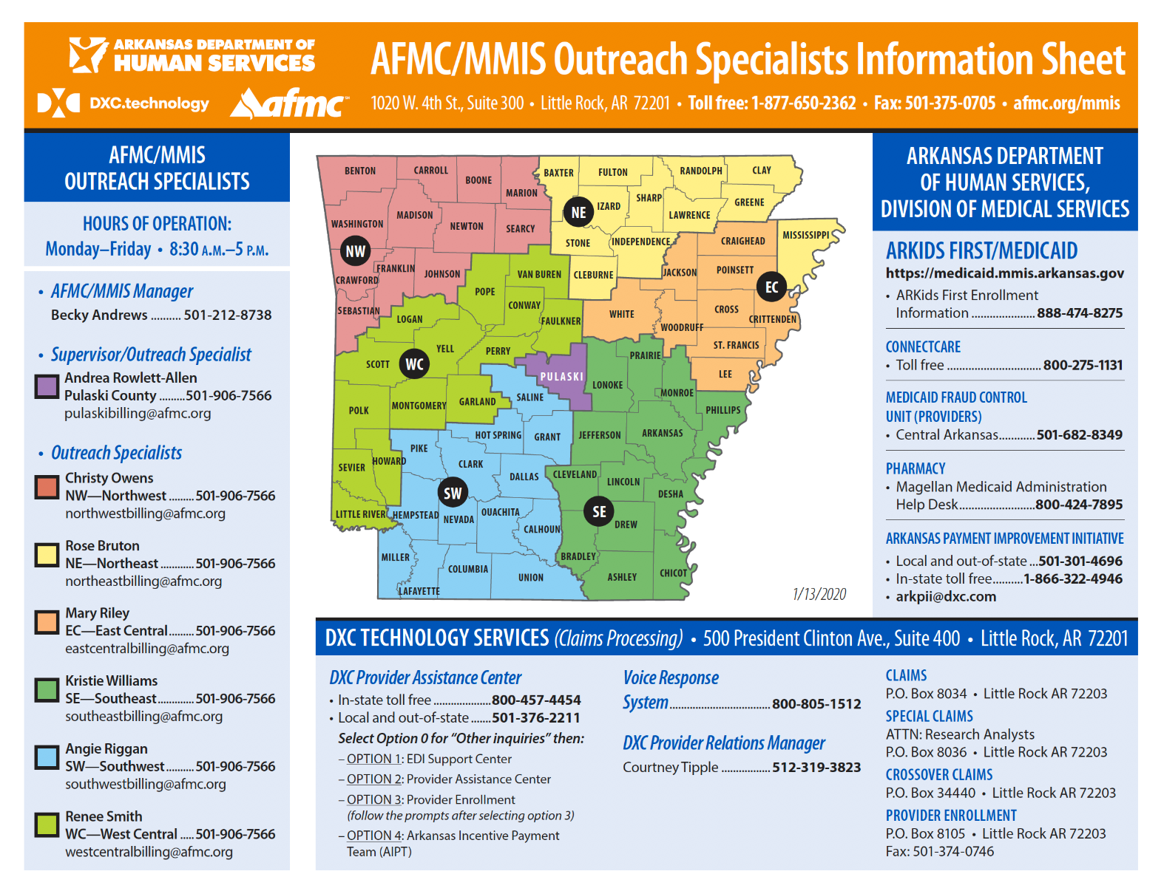
Introduction to MMIS Team
Notes:
Show the map while introducing the team. Explain the difference between MMIS and Provider Relations team.
MMIS-Escalated billing issues, new provider training
Provider Relations-Policy, EPSDT, PCMH, specialty providers-PASSE

Slide 7
Introduction of MMIS Outreach Specialist Team
Notes:
Call our specialists when you have escalated issues.

Slide 8
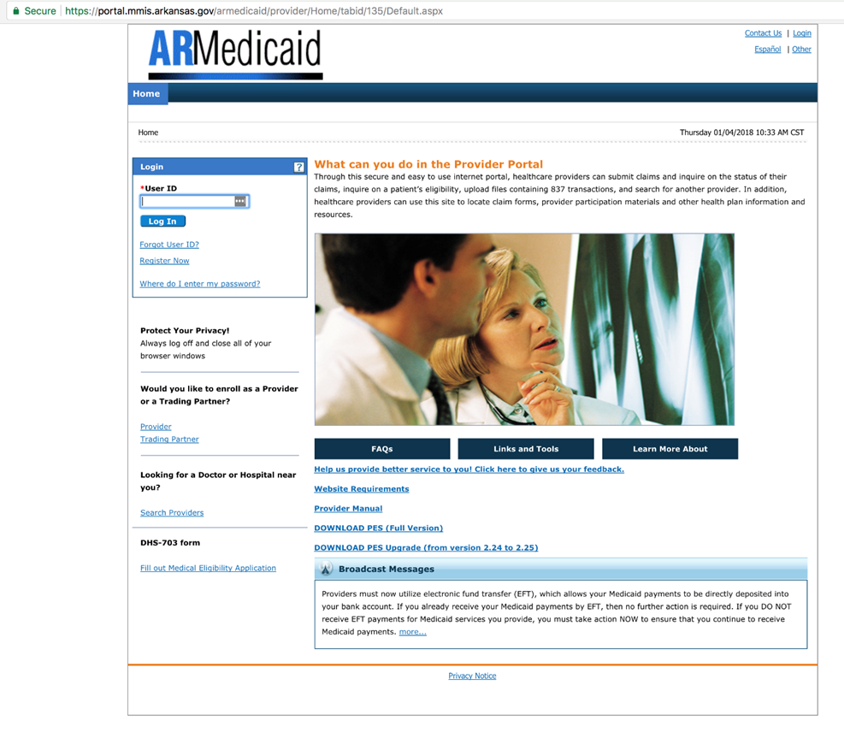
Healthcare Provider Portal
Notes:
Discuss the new and exciting things coming to the Healthcare Portal

Slide 9
Healthcare Portal Features
Online provider enrollment application
Eligibility verification
Submit all claim types (professional, institutional, dental, crossover and third- party)
Ability to edit (adjust), void and copy claims
View status of claims
Attachments for claims and prior authorizations
Prior authorization request and status check
Real-time claims processing
Remittance advice held up to seven years
Secure correspondence
Notes:
Discuss all the things that can be done on the portal.
Next slide covers enhancements

Slide 10
Healthcare Portal Enhancements
Saved claims
Maintain favorites added to claims tab
Provider function tab updated
Affiliation panel under characteristics
Additional DEA number added on application
ReCAPTCHA (coming soon)
Notes:
Saved claims-Allows you to save a claim and come back later to finish
Maintain Favorites-allows providers to maintain favorite providers without having to enter their information every time. This is allowed for each claim type and allows 30 favorites per claim type(dental, institutional and professional)
Provider Function-has been updated to allow providers to upload and search provider enrollment documents. Also, an updated job aid for Uploading Documents will be available on the Medicaid and AFMC website with step by step instructions on how this process will work. Request types include: address change, bank letter/EFT/Void Check update, CLIA update, County Code update, Name change, Medicare update, Taxonomy update, certification and license update, and more.
Affiliation Panel on Characteristics link- there will be an additional affiliation panel to display the providers associated within the group.
Additional DEA number added on application to allow an additional DEA number on the application for a total of two numbers.
ReCAPTCHA-coming soon! An enhanced security measure named reCAPTCHA, will be implemented on the Provider Portal, confirming the user is human. Images presented will require your response. This additional security measure will ensure only humans are interacting with the Provider Portal, ensuring secure services and consistent performance for users. This new security enhancement will apply to select pages slowly over time, minimizing user impact.
will start with eligibility verification for now, but will be spread across the portal. This is
Other enhancements include:
Increased the attachments upload limit to 700mb
PA Inpatient Extensions for MUMP and Extension of Benefits,

Slide 11
Tools and Resources
Medicaid website: https://medicaid.mmis.arkansas.gov
Provider manuals
FAQs
Vendor specs
Fee schedule
Notes:
Please, please, please access your Provider Manuals to ensure that you are billing properly
Fee schedules are very handy to use when you want to know how much we pay for a procedure.
The Fee Schedule has been updated with Rate Increase for Immunizations.

Slide 12
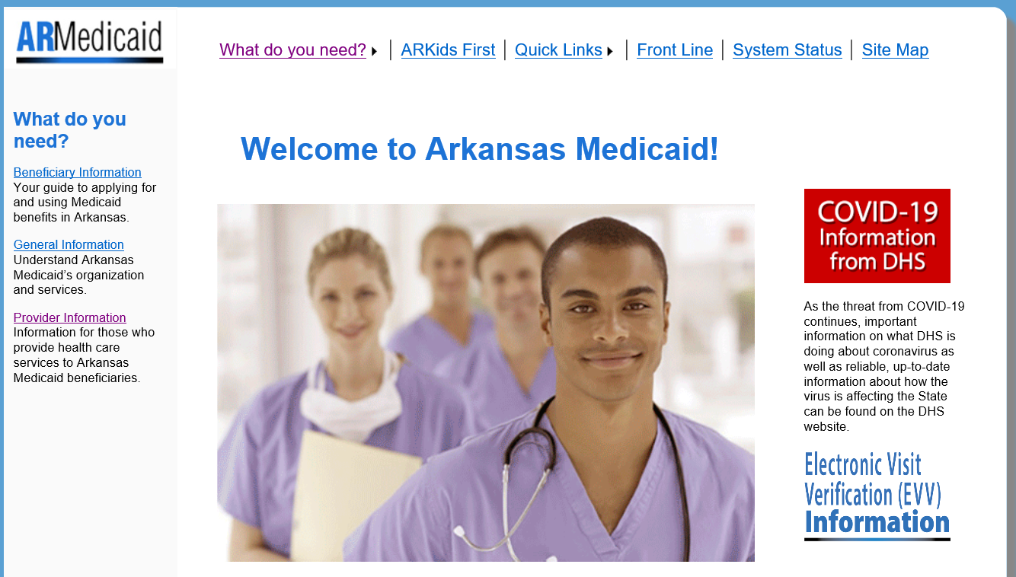
Arkansas Medicaid website: www.Medicaid.mmis.arkansas.gov
Notes:
We have some new training opportunities coming! Please watch for these on the website under Training. See slide

Slide 13
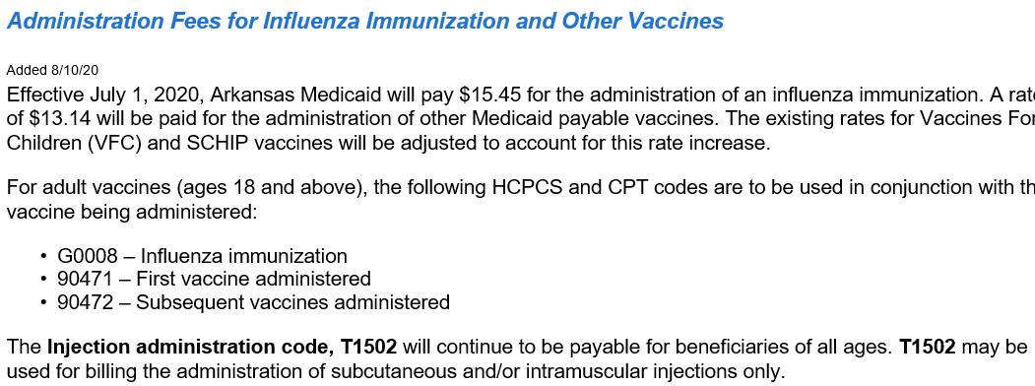
Immunization and Other Vaccines
Notes:
Immunizations and Vaccines information on the website

Slide 14
Training
Notes:
We have some new training opportunities coming! Please watch for these on the website under Training.

Slide 15
Training Opportunities
Notes:
ABW are going on right now. We’ve completed 4 and Our last one will be Nov 5th
Medicaid 101 the last Tuesday of each month.
New Provider Workshop/Webinar November 18th

Slide 16
Who’s Who at Medicaid
Division of Medical Services (DMS) https://humanservices.arkansas.gov/offices
County offices (DCO) https://humanservices.arkansas.gov/offices/dhs-county-office-map
AFMC www.afmc.org
MMIS outreach specialists 501-906-7566 (refer to map for extension #) www.afmc.org/mmis
ConnectCare 800-275-1131 www.seeyourdoc.org
Provider Relations outreach specialists - webpage www.afmc.org/providerrelations
AFMC review department 479-649-8501
eQHealth prior authorization and extension of benefits Ar.pr@eqhs or 888-660-3831
Health Management Systems (HMS) https://hms.com 877-HMS-0184
Office of Medicaid Inspector General (OMIG) 855-527-6644
Magellan Medicaid Administration pharmacy help desk 800-424-7895, Option 2 for Prescribers
DXC Technology 800-457-4454
PASSE-DHS PASSE provider call center 888-889-6451
MCNA Dental 800-494-MCNA
Delta Dental Smiles customer service 866-864-2499
Notes:
Contact information: It’s very important to know who to call
Explain all the different entities in the Medicaid program.
Explain that this is who you call when you have specific questions about their organization. This cuts down on frustration when assistance is needed.
Mention Pharmacies that are going to be administering Flu vaccines must be enrolled in Medicaid and have a PV specialty code and required to bill your claim through DXC
PASSE-contact the PASSE for any questions about a bene that is on the PASSE program. There are three PASSE providers-Summit, Empower and AR Total Care.

Slide 17
Questions?

